Slide 1
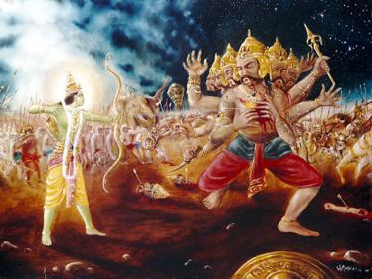
Ramayana
by
Gokul Children

Slide 2
Ramayana Quiz
Sushen
One who advised Sanjivani herb for Laxman
Sampati
Brother of Jadayu
Sunayana
Wife of King Janaka (mother of Sita Devi)
Kevat
Boatman for Rama, Laxman, Sita to cross river
Sumanta
Charioteer of King Dasaratha
Shatananda
Head priest in Mithila (Kula Guru) for Janaka
ShrutKirti
Shatrughna’s wife (Daughter of King Janaka)
Mandavi
Wife of Bharata (Daughter of Janaka)
Urmila
Wife of Lakshman (Daughter of Janaka)

Slide 3
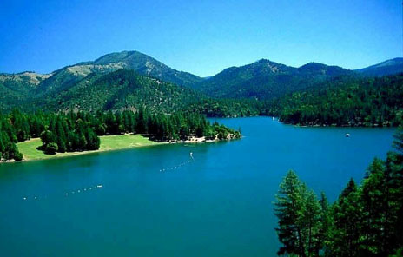
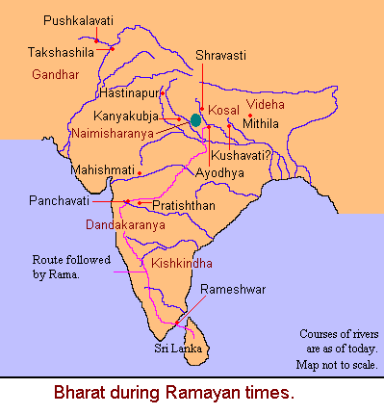
Historical
Times & Places
of
Ramayana

Slide 4
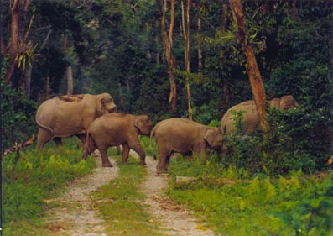
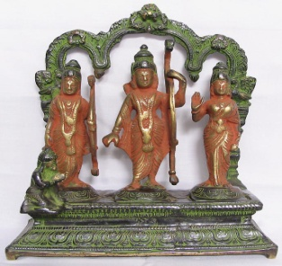
Places of Ramayana Events
Ayodhya
Naimisharanya
Dandakaranya
Kishkindha
Ramesvaram
Sri Lanka

Slide 5
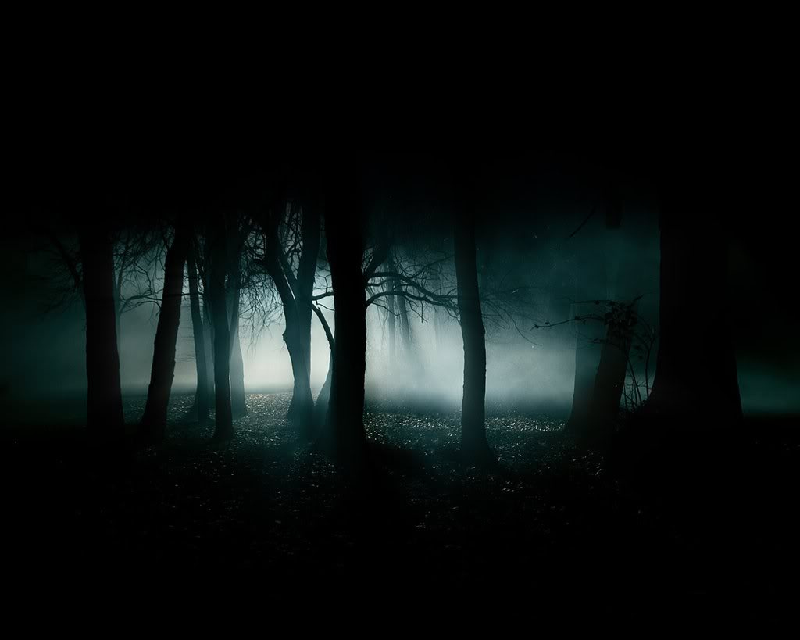
Four Yugas of One Cycle – And the Yuga of Ramayana
Satya Yuga - 1,728,000 years
Treta Yuga - 1,296,000 years
Dwapar Yuga - 864,000 years
Kali Yuga - 432,000 years
Ramayana happened in the last Treta Yuga .
Now we are about 5,000 years of Kali Yuga
Sage Valmiki wrote original Ramayana

Slide 6
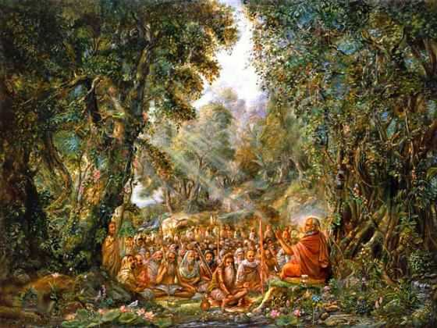
Naimisharanya (UP)
– bank of Gomati River
where Srimad Bhagavatam was later told by Suta Goswami
Notes:
Naimisharnya is the manifestation of Lord Vishnu.
60,000 sages once lived here.
After the Kurukshetra battle, 33,000 sages headed by Saunaka Rishi heard SB again from Suta Goswami.

Slide 7
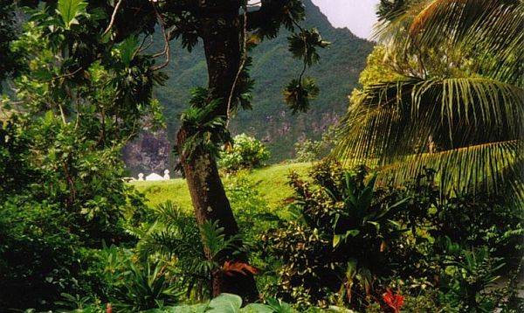
Dandakaranya – where Rishis saw Lord Rama
(Later they came as ‘Vana Chari Gopis’)

Slide 8
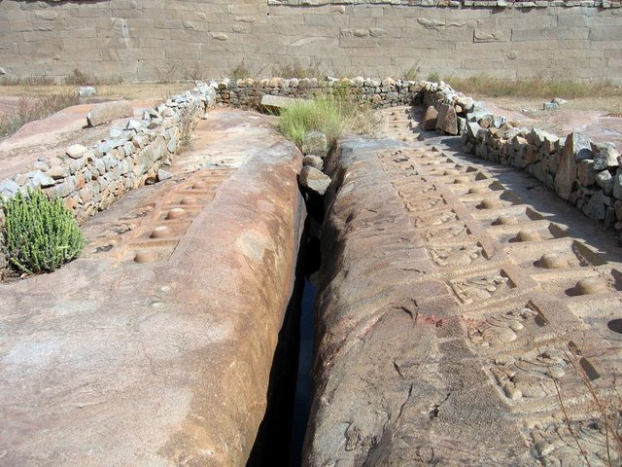
History behind
Humpi
(Kishkindha)

Slide 9
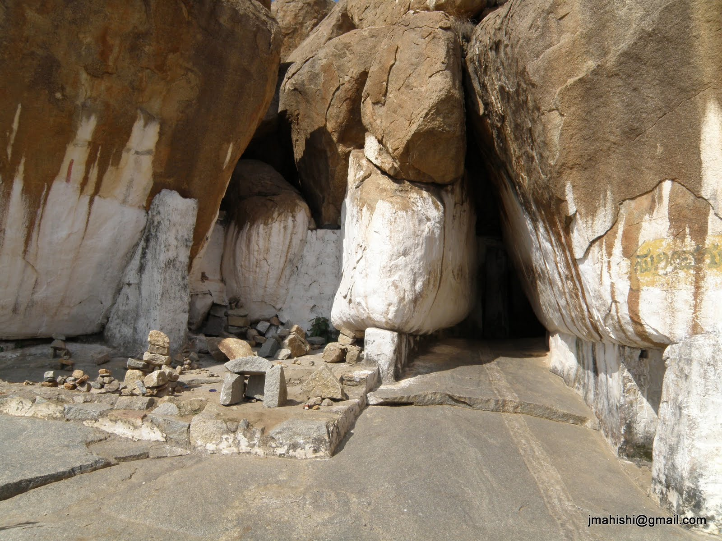
Kishkindha
Sugriva Cave in Hampi
(where Sugriva hid the jewel thrown by Sita)

Slide 10
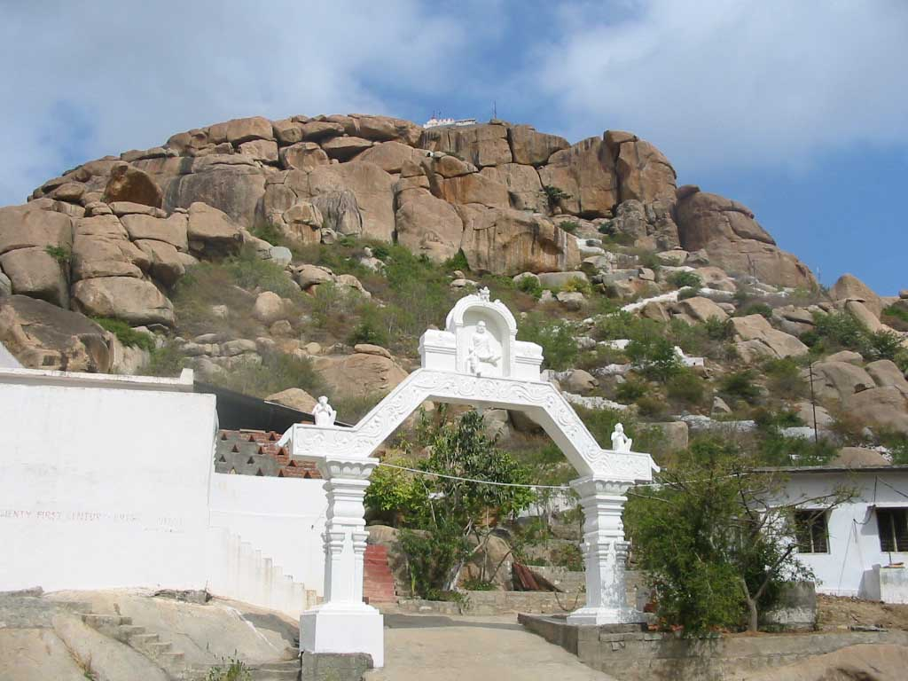
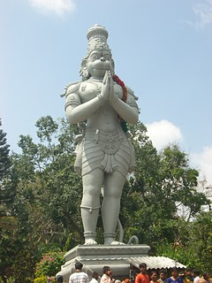
Kishkindha
Anjandri Hill (where Hanuman was born)

Slide 11
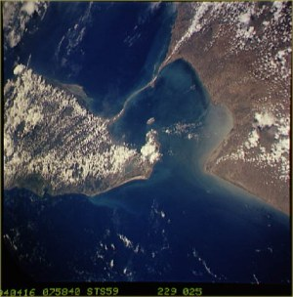
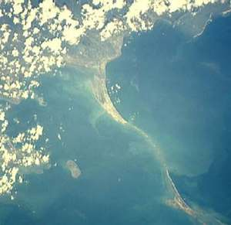
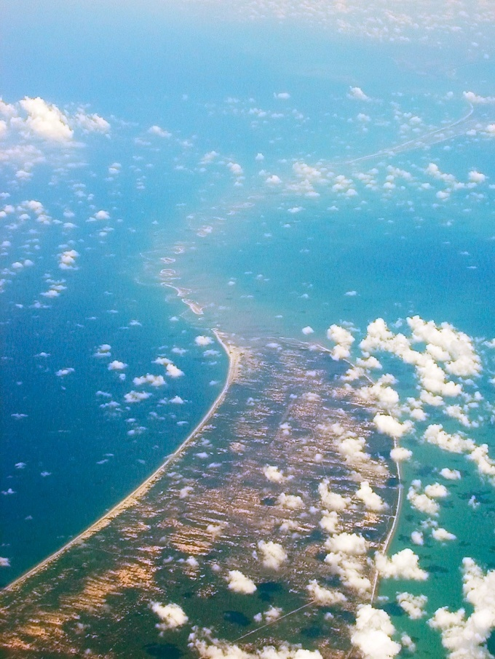
Recent findings about the bridge under the sea

Slide 12
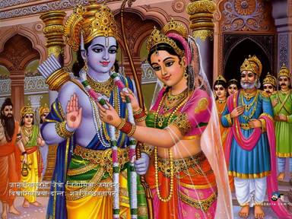
C-08
Rāma Rāghavā Jaya Sìta Nāyakā (2)
[Rāma Rāghava Rājeeva Lochana
Kāmitha Phaladā Kari Varadā]
Krishna Keshavā Jaya Gopi Mādhavā (2)
[Krishnā Keshava Ambuja Lochana
Vânchita Phaladā Yadu Varadā]
[ ...... Sing above fully again – same speed ......]
Rāma Rāghavā….
[ ...... At End, all sing slow...... ]
Rāma Rāghavā Jaya Sìta Nāyakā (2)
Bhajan
By
TBD
12
Notes:
12

Slide 13
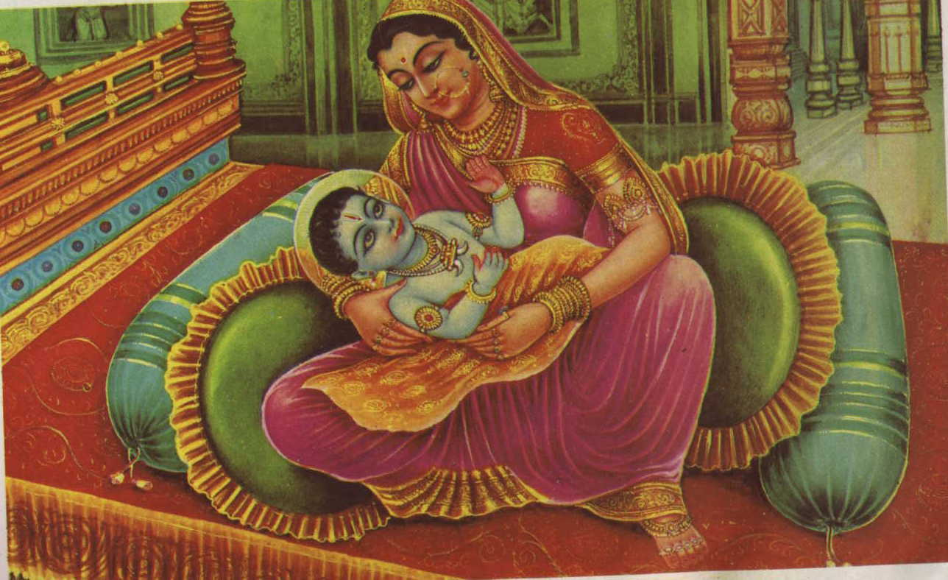
Appearance of Lord Rama

Slide 14
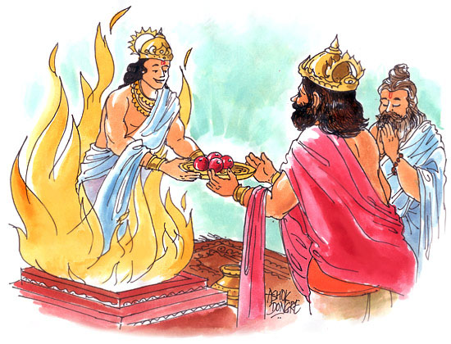
Putresthi-Yajna
King Dasaratha had no sons
Conducted fire rituals
Agni dev gave prasadam

Slide 15
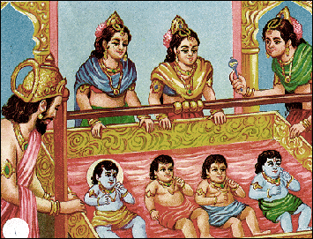
Dasaratha: King of Kosala
Main Queens: Kausalya, Sumitra, Kaikeyi
Sons: Rama, Lakshmana, Satrughna & Bharata

Slide 16
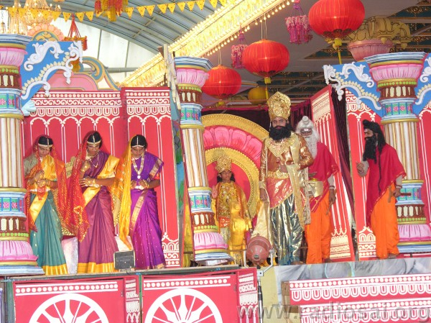
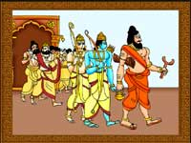
Vasistha Muni was the family Guru
Sage Viswamitra asks for Rama & Lakshmana

Slide 17
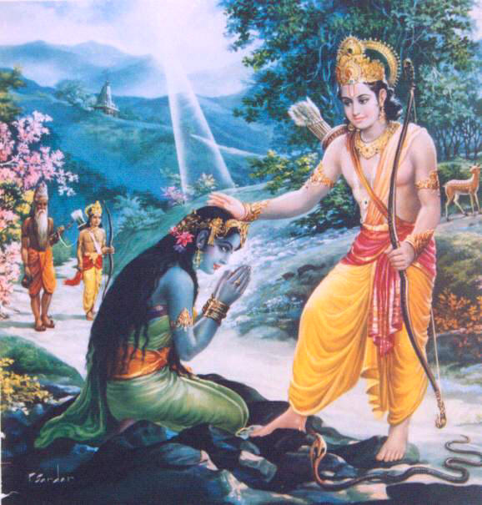
Vimochana for Ahalya from Curse as a Stone
Notes:
Ahalya was created by Brahma, the god of creation, as the most beautiful girl;
The one who crossed the three worlds first should take Ahalya's hand.
Indra was in love with Ahalya and wanted to make her his wife;
He used his powers to cross the three worlds faster than you could count up to five.
What Indra didn't know was that Gautama had already crossed the three worlds;
Indra used his powers to disguise himself as Gautama, having his looks and grace.
Indra and Ahalya were punished for this act, which a curse..
Ahalya, the woman was converted to stone.
When Lord Rama was coming with Sage Vishvamitra, by the touch of His feet on the stone, Ahalya came back to her original form.

Slide 18
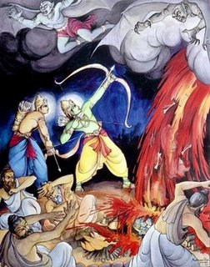
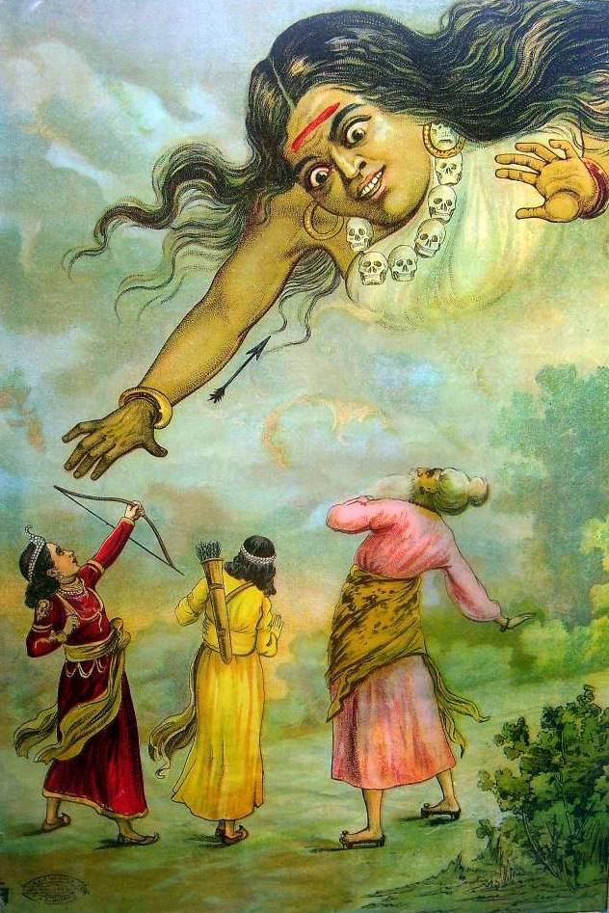
Rama & Laxmana killed many demons
They also killed Tadaka …

Slide 19
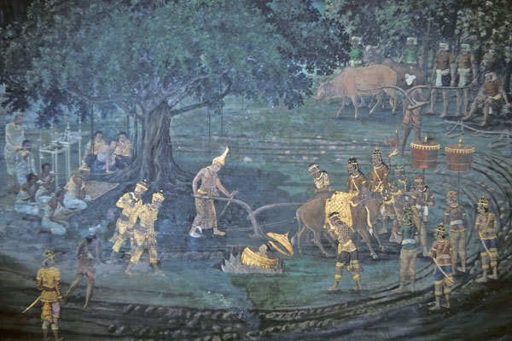
In Mitila, King Janaka gets a girl from ground.. - Sita

Slide 20
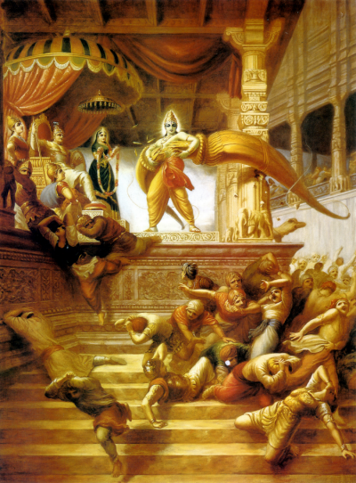
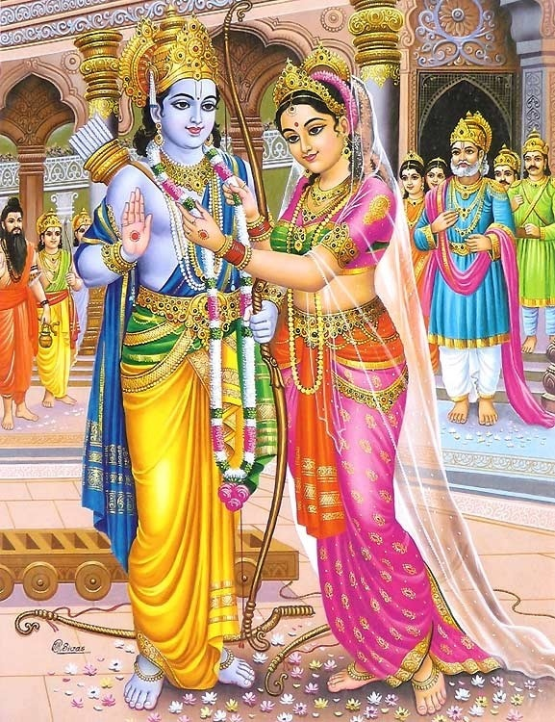
Mithila, Janaka, Bow from Lord Shiva
Sita devi’s Swayamvara
Lord Rama Marries Sita Devi

Slide 21
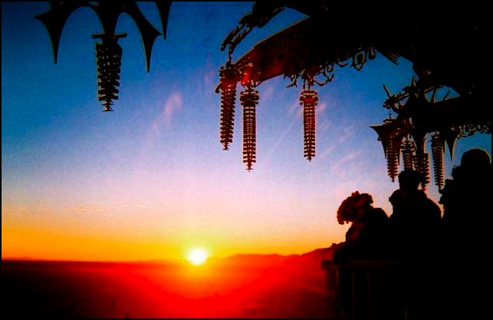
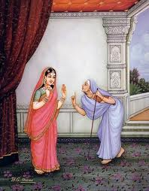
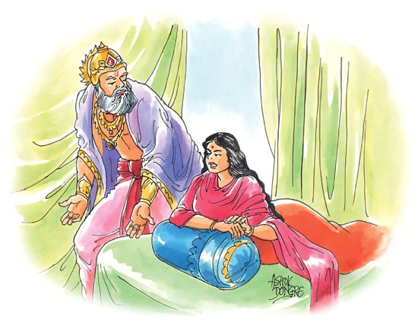
Kaikeyi
Mantharai (kooni)
Kaikeyi used 2 boons..
Bharata to be King
Rama 14 Years to forest

Slide 22
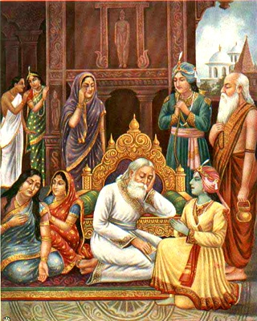
Rama leaves the Kigndom and goes to Forest..
Lakshmana also goes with..
And Sita Devi as well..

Slide 23
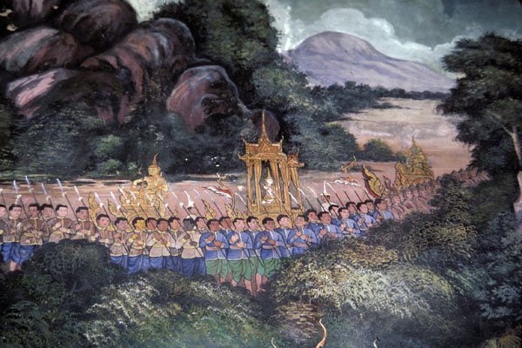
Lord Rama, Sita Devi & Lakshmana going to forest
Citizens followed for a long distance..

Slide 24
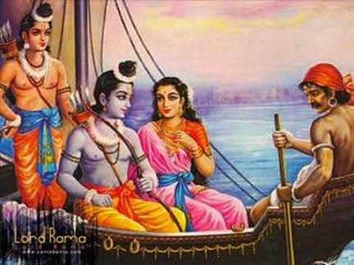
Lord Rama, Sita Devi & Lakshmana going to forest
Kevat – the boatman

Slide 25
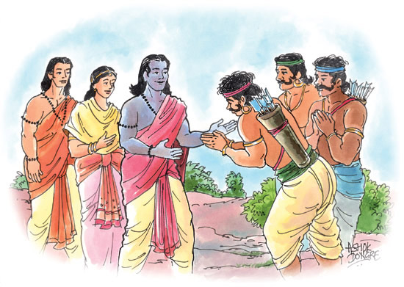
Adivasi Guhaka’s Devotion for Lord Rama
Guhaka is considered as Rama’s another brother
Offered food and Invited to stay in his residence
Lord Rama could not accept? Why?

Slide 26
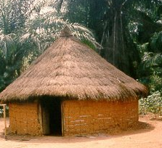
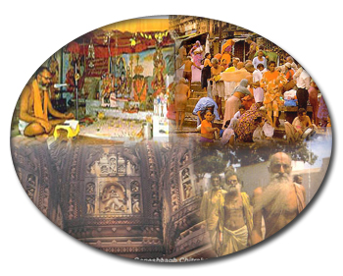
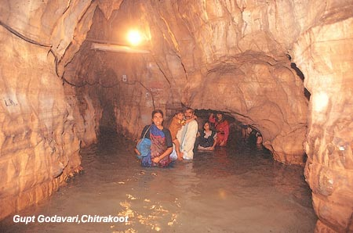
Chitrakoot

Slide 27
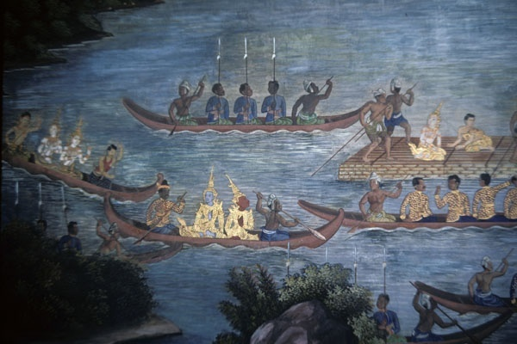
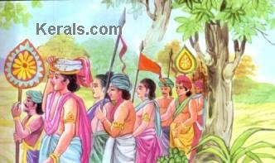
Bharata takes Rama’s footwear
Bharata told that father Dasaratha had died
Every one shocked to hear
Rama Finished all the rituals…

Slide 28
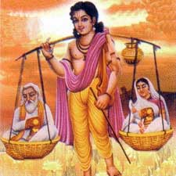
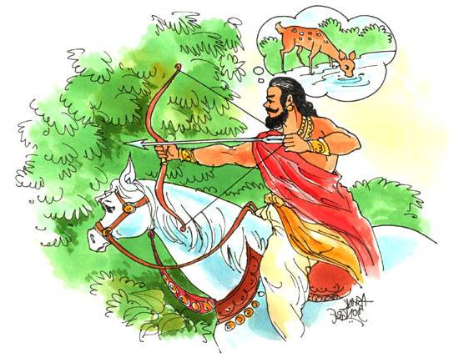
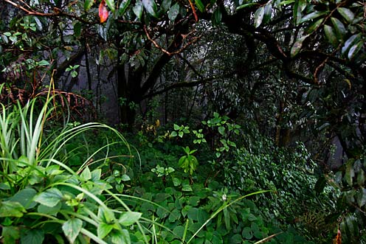
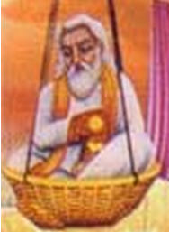
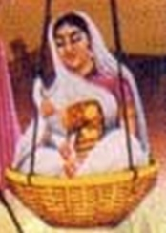
Story of Shravan Kumar

Slide 29
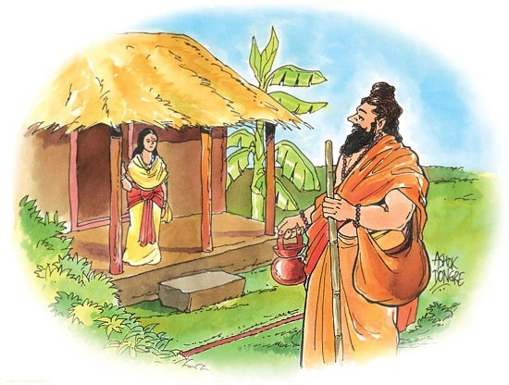
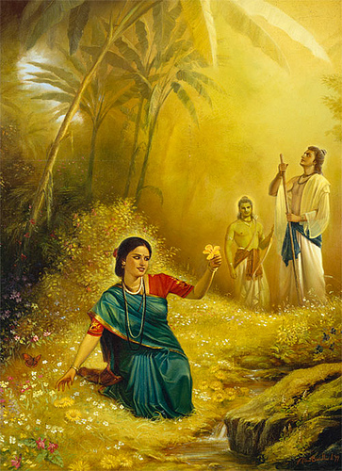
Sita Rama in Panchavadi Forest
Lakshmana had left even his own wife..
He never slept for all the 14 years!

Slide 30
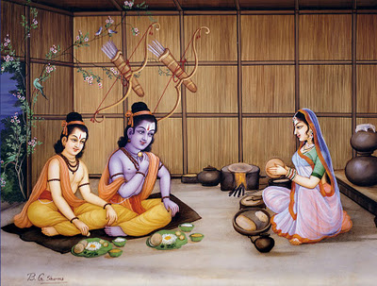
Sita Rama and Lakshman living in Panchavadi Forest

Slide 31
C-04.1
Kāusalyā suprajā Rāma chandrā
Sîtā manoharā Rāgha vendrā
(+Chorus: [Kausalya ..., Sita ....])
Dîna dayāla Pari pūrna krpālā
Jay-jay bhakta mandārā Rāgha vendrā
(+Chorus: [Kausalya ..., Sita ....]) (2 times chorus)
Ānanda sāgarā Muralee dharā
Neelāmbari radhe shyama Venu gopālā (No Chorus)
(Chorus: [Ananda ...., Neelambari ....])
Nanda yasodā Ānanda kishorā
Jay-jay Gokula bālā jay Bāla gopālā
(+Chorus: [Kausalya ..., Sita ....]) (2 times chorus)
Bhajan
By
TBD
31
Notes:
31

Slide 32
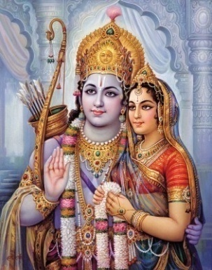
C-04.2
Ānanda śayanā Ādi nārayanā
Saccid ānandā sri Satya nārāyanā (No Chorus)
(Chorus: [Ananda ...., Neelambari ....])
Bhaya-bhaya haranā jay Vandita charanā
Raghu kula tilakā sri Raja lochanā
(+Chorus: [Kausalya ..., Sita ....]) (2 times chorus)
Nārāyanā hari Nārāyanā (2)
Nārāyanā hari Nārāyanā (2)
(All sing slow to complete)
[Kāusalyā suprajā Rāma chandrā,
Sîtā manoharā Rāgha vendrā]
32
Notes:
32

Slide 33
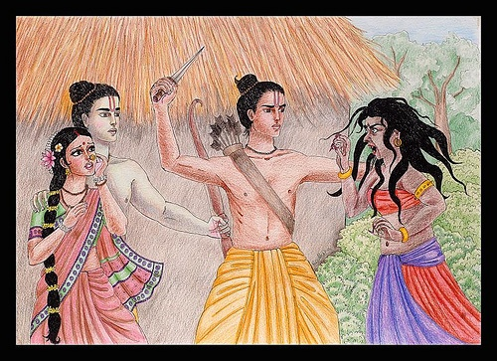
Soorpanaka wanted to marry Lord Rama
Lakshmana cuts her nose..
Surpanaka tells this to brother Ravana

Slide 34
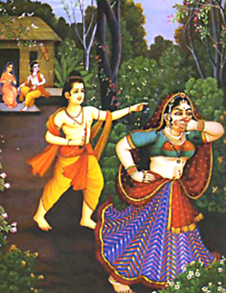
Lakshmana cuts the nose of Soorpanaka..

Slide 35
Surpanaka complains to brother Ravana

Slide 36
Soorpanaka was later born as Kubja in Krishna Leela
There was also another reason why Soorpanaka’s nose was cut …

Slide 37
Sita Devi wanted the golder deer..
Ravana’s uncle Marichi
disguised as a golden deer!
Sita Devi wanted the beautiful golden deer

Slide 38
Ravana heard the beauty of Sita Devi from Soorpanaka.
It was his plan to make uncle Marichi as a golden deer.
Ravana abducted Sita Devi ( actually shadow of Sita Devi)

Slide 39
The circle by Laxmana was protecting Sita..

Slide 40
When Sita Devi crossed the fire, Ravana could kidnap Sita Devi…

Slide 41
Ravana did not kidnap the real Sita devi..!.. Who was she then?
Notes:
Was that the real Sita devi Ravana kidnap?
No..
In Kurma Purana, it is written that before Ravana kidnapped, Sita Devi took the shelter of Agni Deva.
Agni Deva kept the real Sita devi, but delivered a Maya Sita for Ravana to kidnap.
Who is this Maya Sita.. It was goddess Padmavati (Alamelu Mangai), a form of goddess Lakshmi.
Padmavati, in one of her births as Vedavati was attempted once by Ravana to molest, but she escaped and cursed Ravana that she will kill him.
Because she was touched by Ravana, she entered Agni. That time also Agni Deva rescued her and made her pure and was served by the wife of Agni.

Slide 42
42
Notes:
The Srinivasa Kalyanam related to the history of Tirumala (Tirupathi) is this Padmavati (Alamelu) – a form of Lakshmi.

Slide 43
Jadayu saw Ravana taking Sita Devi
He fought against Ravana
Ravana cut Jadayu’s wing
Jadayu fell down on the ground
Ravana continued to Lanka with Sita Devi

Slide 44
Lord Rama and Lakshmana searching for Sita devi
They were even asking the trees and creepers..
Then they saw Jadayu on ground
Jadayu told what happened
He died on the lap of Rama..

Slide 45
Lord Rama happens to meet Sabhari..
45

Slide 46
With affection, Sabhari offers many fruits to Lord Rama
46

Slide 47
Hanuman was assigned the task of searching Sita Devi in the South..
Lord Rama gave His ring to hanuman for identitity to Sita Devi

Slide 48
Hanuman
Meets
Lord Rama
Hanuman from
Kishkindha
Sugriva
Vaali

Slide 49
Lord Rama Kills Vali by shooting arrow from behind a tree

Slide 50
C-07
Rāma Bhakta Jaya Ânjaneyā
Jaya Bala Bheema Kapeesvarā
Rāma Bhakta Jaya Ânjaneyā
Lankayai Thaganam Seitha Mahā Veera
Mooligai Malaiyāl Vuyir Kāththa Theera
Rāma Nāmam Sollum Vānara Sǔrā
[ ------------- Faster at 1.5 speed----------- ]
Rāma Bhakta Jaya Ânjaneyā
Jaya Bala Bheema Kapeesvarā
Rāma Bhakta Jaya Ânjaneyā
Lankayai Thaganam Seitha Mahā Veera
Mooligai Malaiyāl Vuyir Kāththa Theera
Rāma Nāmam Sollum Vānara Sǔrā
[ ----------- Slow - All sing to complete ------- ]
Rāma Bhakta Jaya Ânjaneyā
Bhajan
By
TBD
50
Notes:
50

Slide 51
Vali came as hunter (Jara) and shot arrow at Krishna’s feet
What do we learn from this?

Slide 52
Hanuman had to be told about His strength…
Then he jumps to Sri Lanka..

Slide 53
But he lands into the mouth of Surasa
Escapes and reaches Sri Lanka

Slide 54
Hanuman finds Sita Devi in the garden of Ravana (Ashoka Vana)..

Slide 55
Hanuman gives the ring of Lord Rama to Sita Devi..
By:Yashica
55

Slide 56
Sita Devi asks that Lord Rama come and rescue her..
Hanuman ready to depart back to Lord Ram with the good news..
56

Slide 57
Soon Hanuman was caught by Ravanas men..
57

Slide 58
Hanuman was not given a seat..
But he made a mush higher seat by coiling his own tail.

Slide 59
C-01
[Bhaja Rāmam Bhaja Rāmam
Bhajare Mānasa Bhaja Rāmam] (2)
Kalyāna Rāmam Bhaja Rāmam
Kòdanda Rāmam Bhaja Rāmam
[Pāttabhi Ramam Bhaja Ramam,
Pāvana Ramam Bhaja Rāmam]
[Bhaja Rāmam Bhaja Rāmam, Bhajare
Mānasa Bhaja Rāmam]
Kalyāna Rāmam Bhaja Rāmam
Kòdanda Rāmam Bhaja Rāmam
[Pattabhi Rāmam Bhaja Rāmam,
Pāvana Rāmam Bhaja Rāmam]
[Bhaja Rāmam Bhaja Rāmam
Bhajare Mānasa Bhaja Rāmam] (3)
Bhajan
by
TBD
59
Notes:
59

Slide 60
Punishment given to hanuman to set his tail on fire..
60

Slide 61
Hanuman runs around the entire Lanka setting up fires

Slide 62
Then he puts off the fire on the tail by plunging into the ocean..

Slide 63
Hanuman Brings good news to Lord Rama

Slide 64
Lord Rama embraces Hanuman with great affection..

Slide 65
Rama asked Varuna to help But Varuna did not respond
Rama got angry
About to shoot arrow..
Varuna suggested Nila & Nala to help
(Nala monkey was the son of Viswakarma)

Slide 66
Vibhishana Surrenders and Joins the side of Lord Rama

Slide 67
In Valmiki Ramayana, there is NO mention of Lord Rama worshipping Lord Shiva. It was a later interpretation.
According to Adhyarma Ramayana, Lord Rama worshiped Lord Shiva before the war. This was also a later addition.
As per Tulasi Ramayana, he worshipped after the war.

Slide 68
Vanara Army built floating bridge
68

Slide 69
The fighting had started ..
Notes:
Describe all the preparations for the war..
The armies on each side

Slide 70
Lakshmana was shot by arrow by Meganath
Hanuman was tasked to bring the herb (sanjivani) from the mountain..

Slide 71
Hanuman brought the whole mountain..
Notes:
But he forgets the name of the herb..
So hanuman decides to bring the whole mountain!
With the herb, Lakshamana came out of unsconsciousness.

Slide 72
Ravana Came To Fight
With Lord Rama
Ravana could not be killed Slain heads came back..
Slain hands, all came back…

Slide 73
Ravana’s chariot was destroyed. But he fought from the sky
Could not be killed. Vibhesana told about Ravana’s weak point..
Rama hits Ravana’s navel with arrow! Ravana dies.
73

Slide 74
C-12.1
[Sri Rāma chandra Raghu Rāma chandra
Raghu Rāma chandra Bhagavan
Sri Dhanya Dhanya Sitāpi Rāma
Sudhir Ātma Rupa Rāmā] (2)
[Jānaki Ramana Rāghavā
Vimala Veerya Surya Kula Jātā]
[Sri Rāma Rāma Raghu Veera Rāma
Karunārthra Netra Rāma] (No chorus)
(All): Sri Rāma Rāma Jaya Rāma Rāma
Jaya Rāma Rāma, Jaya Rāmā
[Sri Rama chandra …(full para)..]
Bhajan
By
TBD
74
Notes:
74

Slide 75
C-12.2
[Moutikā Harana Bhusita Bhuvana
SoundaryĀtma Jaya Rāmā]
[Ānanda Rupa Nikam Ānta Sāra
Nikil Ātma Rupa Rāmā] (No chorus)
(All): Sri Rāma Rāma Jaya Rāma Rāma
Jaya Rāma Rāma, Jaya Rāmā
[Sri Rama chandra …(full para)..]
Sri Rāma chandra Raghu Rāma chandra
Raghu Rāma chandra Bhagavan
Sri Dhanya Dhanya Sitāpi Rāma
Sudhir Ātma Rupa Rāmā
Sudhir Ātma Rupa Rāmā….
75
Notes:
75

Slide 76
Sita Devi undergoing Agni Pariksha (fire test)

Slide 77
Lord Rama, Sita Devi, Lakshmana,
Vibhishana, Vanaras all came in a
Pushpaka Vimana to Ayodhya

Slide 78
Return of Rama, Sita and Laxmana
Vibeeshana also came with them
Deepavali is celebrated as Rama’s Return

Slide 79
To everyone’s surprise, Lord Ram went to Kaikeyi first to pay His obeisances..
Why?
(Kaikey was the one who banished Lord Rama for 14 years)

Slide 80
Vashishtha performed rituals
Vibheesana became king of Lanka
All Vanara armies present
Gifts were given to all
Coronation of Lord Rama

Slide 81
Sita Devi gives hanuman her precious perl necklace..
But Hanuman did not know what to do, and was biting each perl and looking inside..
Every one laughed.
He said, “I am looking looking every perl to see if Lord Rama is inside..
81

Slide 82
Hanuman then opens up his heart and show Lord Ram and Sita Devi sitting inside his heart!

Slide 83
C-11.1
Sri Ram…. Sri Ram…
Rupak Tala
Śrī Rāmachandra Kripalu Bhaja Mana
Haraṇa Bhava Bhaya Dāruṇam ..... (Śrī Rām…)
Nava Kanja Lochana Kanja Mukha Kara
Kanja Pada Kanjaruṇam … (Śrī)
Kandarpa Agaṇita Amita Chabi
Nava Nīla Nīrada Sundaram
Pata Pīta Mānahu Tadita Ruchi Suchi
Naumi Janaka Sutāvaram … (Śrī)
Bhaja Dīna Bandhu Dineśa
Dānava Daitya Vamśa Nikandanam
Raghu Nanda Ānanda kanda Kauśala
Canda Daśaratha Nandanam … (Śrī)
Bhajan
By
TBD
83
Notes:
83

Slide 84
C-11.2
Śrī Rāmachandra Kripalu Bhaja Mana
Haraṇa Bhava Bhaya Dāruṇam (Śrī Rām…)
Nava Kanja Lochana Kanja Mukha Kara
Kanja Pada Kanjaruṇam
Śira Mukuta Kunḍala Tilaka
Cāru Udāra Anga Vibhuśaṇam
Ājanubhuja Śara Chāpa Dhara
Sangrāma Jita Khara Duṣaṇam … (Śrī)
Iti Vadati Tulasī Dāsa
Śankara Śeṣa Muni Mana Ranjanam
Mama Hrdaya Kanja Nivāsa Kuru
Kāmādi Khala Dala Ganjanam … (Śrī)
84
Notes:
84

Slide 85
End of Episode

